Slide 1
SCHOOL OF ENGINEERING, ELECTRICAL AND ELECTRONIC ENGINEERING
NETWORKS 4_ Week E_
Ronald van Buuren
May 2023

Slide 2
net4 program by week
1st order RC networks – discharging – DC source
1st order RC networks – charging –DC source
RL networks – Steady-state DC
RL networks – Switched DC source
RC & RL networks – complementary solution
<spare week>
Exam Prep

Slide 3
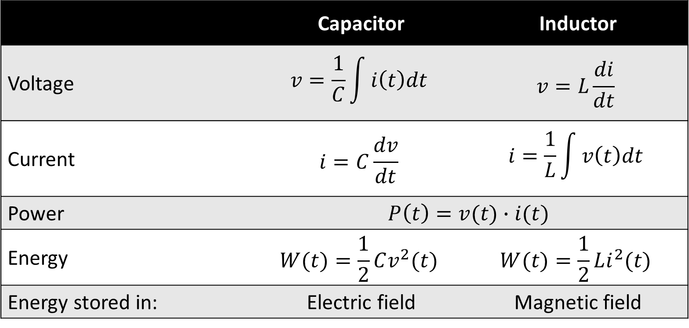
Capacitor & inductor relations
 | Capacitor | Inductor
Voltage | $$v=\frac{1}{C}\int{i\left(t\right)dt}$$ | $$v=L\frac{di}{dt}$$
Current | $$i=C\frac{dv}{dt}$$ | $$i=\frac{1}{L}\int{v\left(t\right)dt}$$
Power | $$P\left(t\right)=v(t)∙i(t)$$
Energy | $$W(t)=\frac{1}{2}Cv^{2}(t)$$ | $$W(t)=\frac{1}{2}Li^{2}(t)$$
Energy stored in: | Electric field | Magnetic field

Slide 4
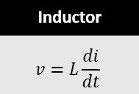
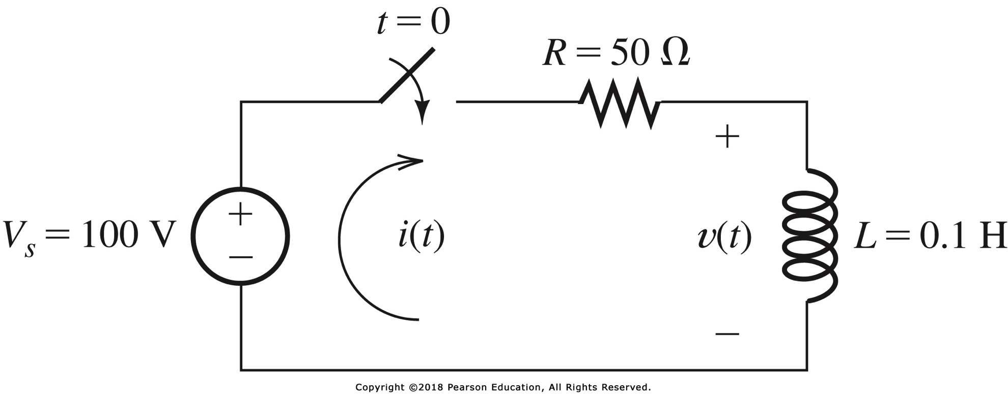
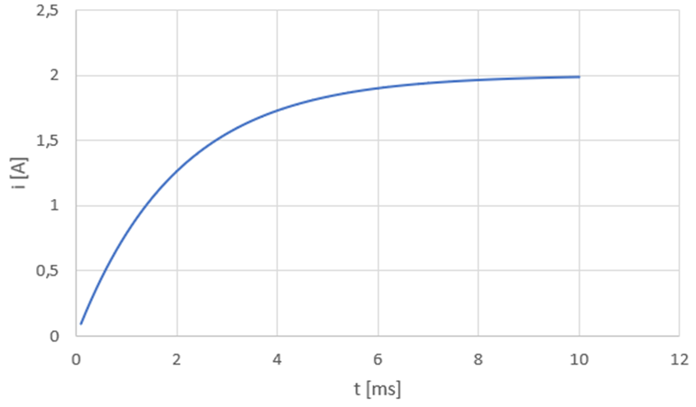

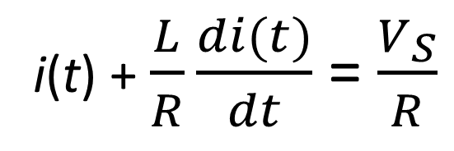
week D: switched DC source, rl circuits
At $t=0$ we close the switch
V_{S} - i(t)·R - Ldi/dt = 0
i(t) + $\frac{L}{R}\frac{di(t)}{dt}$ = $\frac{V_{S}}{R}$
i(t) = 2-2e^{-500t} A

Slide 5
this week
Find expressions for i(t) and v(t) using just steady-state values
and smart reasoning ☺
Switching on AC sources

Slide 6
RL circuits – via dc steady state
Find expressions for i(t) and v(t) for t > 0

Slide 7
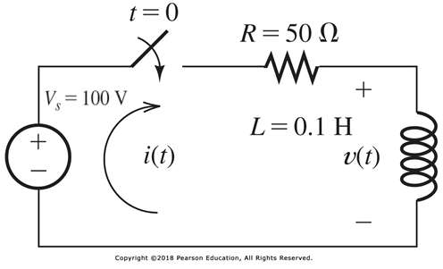
RL circuits – via dc steady state
at t = 0- s, i(t) = 0 A
at t = ∞, i(t) = 100/50 = 2 A
time constant τ = L/R = 0.002 s = 2 ms
general form i(t) = K₁ + K₂e^{-t/τ}
we know all we need to know:
for t = ∞, we get K₁ = 2 A
for t = 0- s: K₁ + K₂ = 0 → K₂ = -2 A
i(t) = 2 - 2e^{-t/0.002} = 2 – 2e^{-500t}

Slide 8


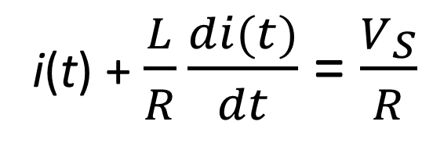
general (AC) sources
i(t) + $\frac{L}{R}\frac{di(t)}{dt}$ = $\frac{V_{S}}{R}$
General form:
$$τ\frac{dx(t)}{dt}+x\left(t\right)=f(t)$$
τ depends only on component values (τ = RC, τ = L/R)
x(t) i(t), v(t) from circuit equations (KVL, KCL)
f(t) source(s)

Slide 9

complementary solution
$$τ\frac{dx(t)}{dt}+x\left(t\right)=f(t)$$

Slide 10
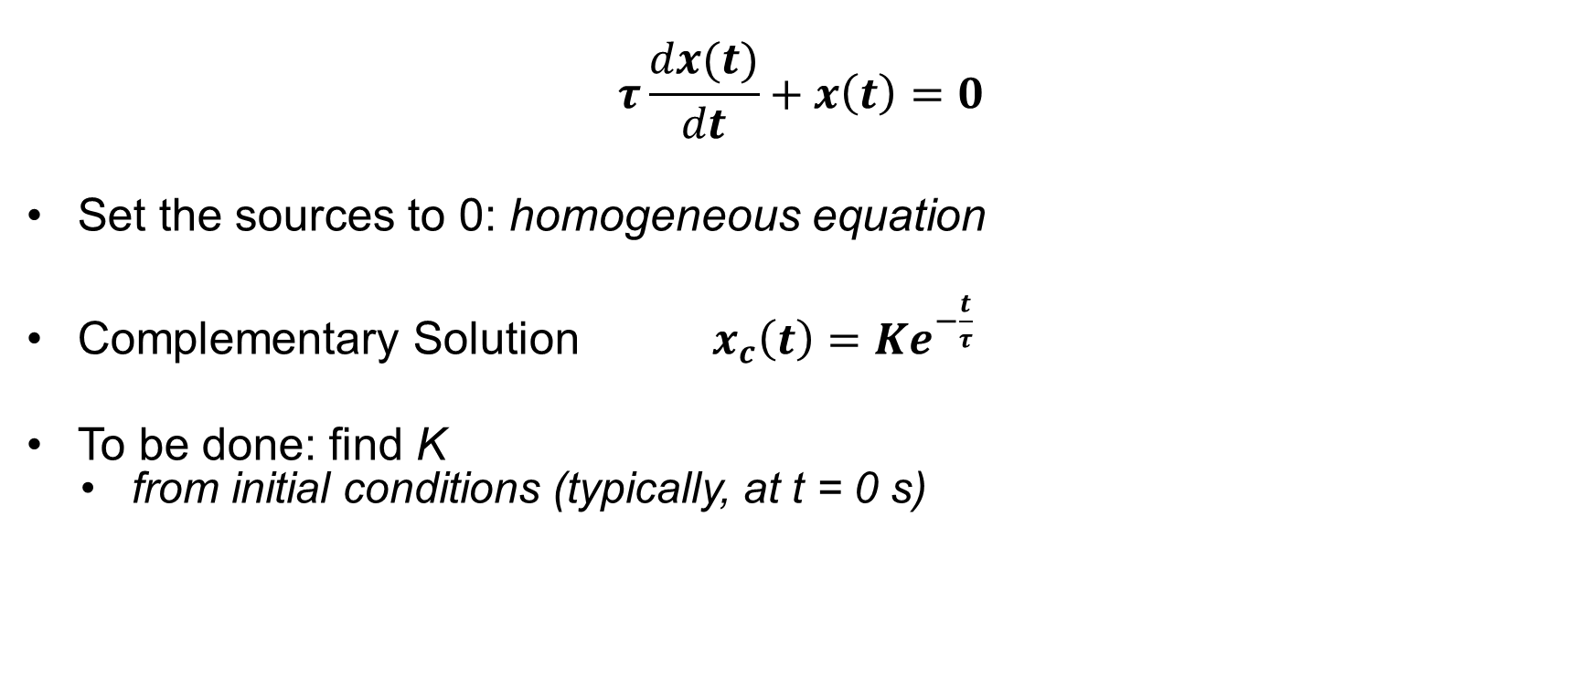
complementary solution
$$τ\frac{dx(t)}{dt}+x\left(t\right)=0$$
Set the sources to 0: homogeneous equation
Complementary Solution $x_{c}\left(t\right)=Ke^{−\frac{t}{τ}}$
To be done: find K
from initial conditions (typically, at t = 0 s)

Slide 11
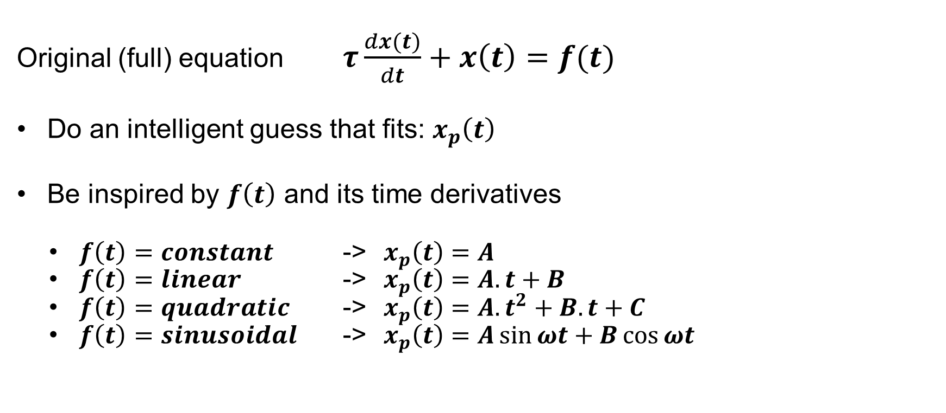
particular solution
Original (full) equation $τ\frac{dx(t)}{dt}+x\left(t\right)=f(t)$
Do an intelligent guess that fits: $x_{p}\left(t\right)$
Be inspired by $f\left(t\right)$ and its time derivatives
$f\left(t\right)=constant$ -> $x_{p}\left(t\right)=A$
$f\left(t\right)=linear$ -> $x_{p}\left(t\right)=A.t+B$
$f\left(t\right)=quadratic$ -> $x_{p}\left(t\right)=A.t^{2}+B.t+C$
$f\left(t\right)=sinusoidal$ -> $x_{p}\left(t\right)=A\sin{ωt}+B\cos{ωt}$

Slide 12
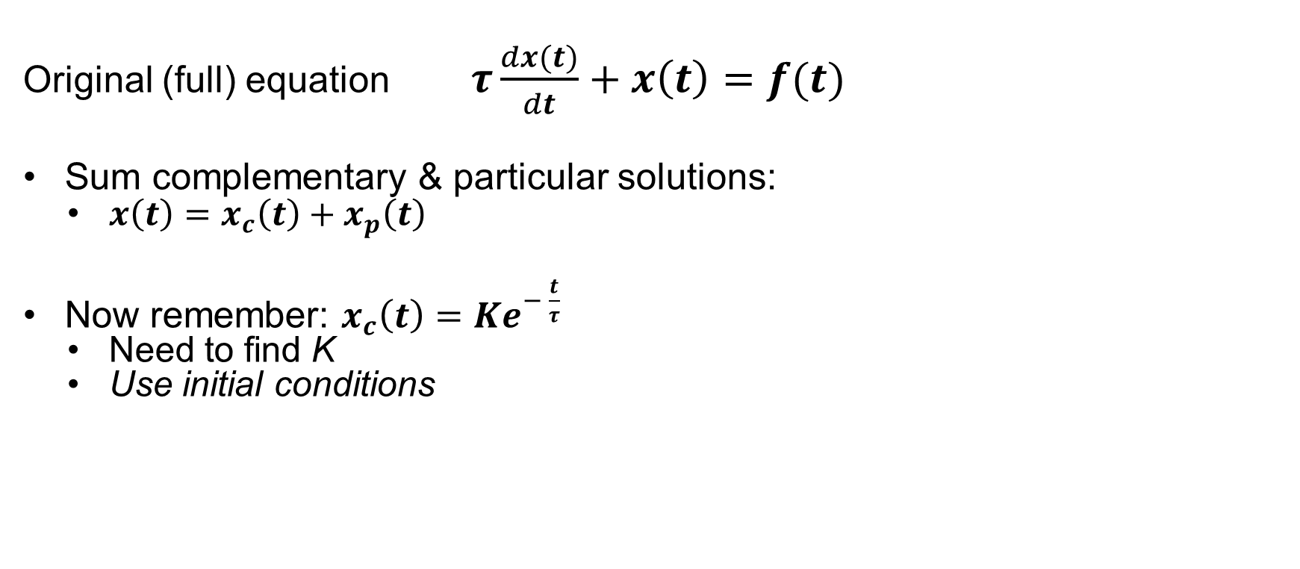
combine complementary & particular solutions
Original (full) equation $τ\frac{dx(t)}{dt}+x\left(t\right)=f(t)$
Sum complementary & particular solutions:
$x\left(t\right)=x_{c}\left(t\right)+x_{p}\left(t\right)$
Now remember: $x_{c}\left(t\right)=Ke^{− \frac{t}{τ}}$
Need to find K
Use initial conditions

Slide 13
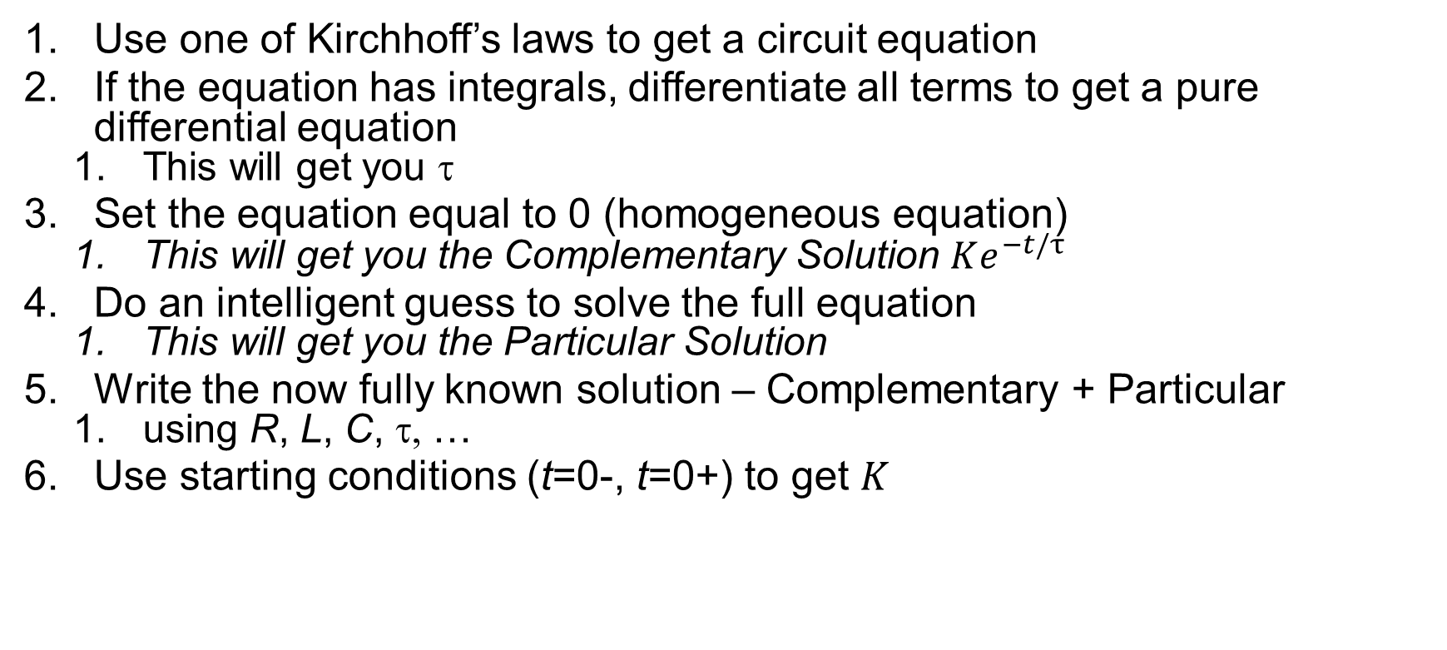
new Recipe for simple circuits (RC & RL)
Use one of Kirchhoff’s laws to get a circuit equation
If the equation has integrals, differentiate all terms to get a pure differential equation
This will get you τ
Set the equation equal to 0 (homogeneous equation)
This will get you the Complementary Solution $Ke^{−t/τ}$
Do an intelligent guess to solve the full equation
This will get you the Particular Solution
Write the now fully known solution – Complementary + Particular
using R, L, C, τ, …
Use starting conditions (t=0-, t=0+) to get $K$

Slide 14
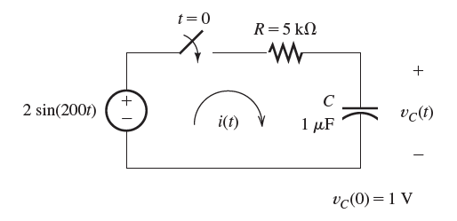
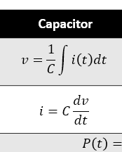


example 4.6
Flashback from NET4 week B
KCL at top-right node: sum = 0
incoming: (v_{C}(t) – V_{S})/R
outgoing: C·dv_{C}/dt

Slide 15
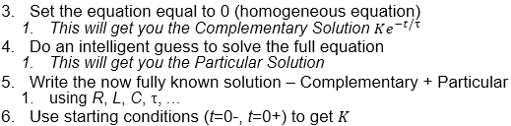
example 4.6
Apply the recipe step 3
Compl. Sol. v_{CC}(t) = Ke^{-t/RC}

Slide 16
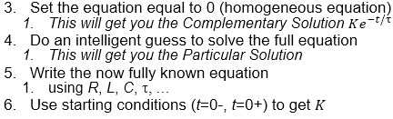
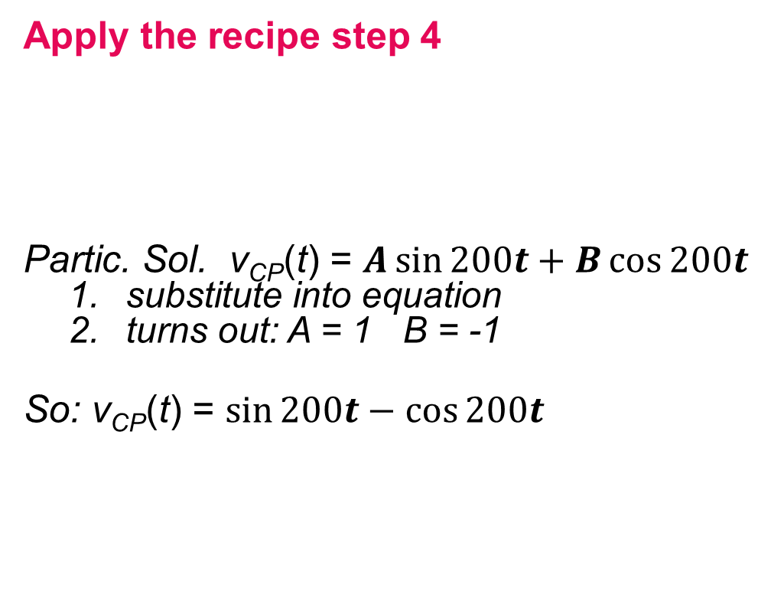
example 4.6
Apply the recipe step 4
Partic. Sol. v_{CP}(t) = $A\sin{200t}+B\cos{200t}$
substitute into equation
turns out: A = 1 B = -1
So: v_{CP}(t) = $\sin{200t}−\cos{200t}$

Slide 17
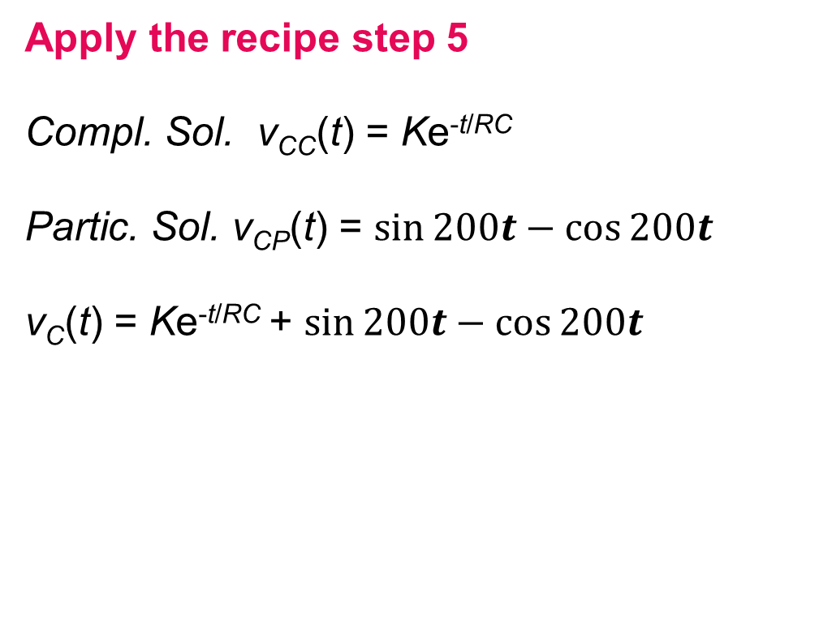
example 4.6
Apply the recipe step 5
Compl. Sol. v_{CC}(t) = Ke^{-t/RC}
Partic. Sol. v_{CP}(t) = $\sin{200t}−\cos{200t}$
v_{C}(t) = Ke^{-t/RC} + $\sin{200t}−\cos{200t}$

Slide 18
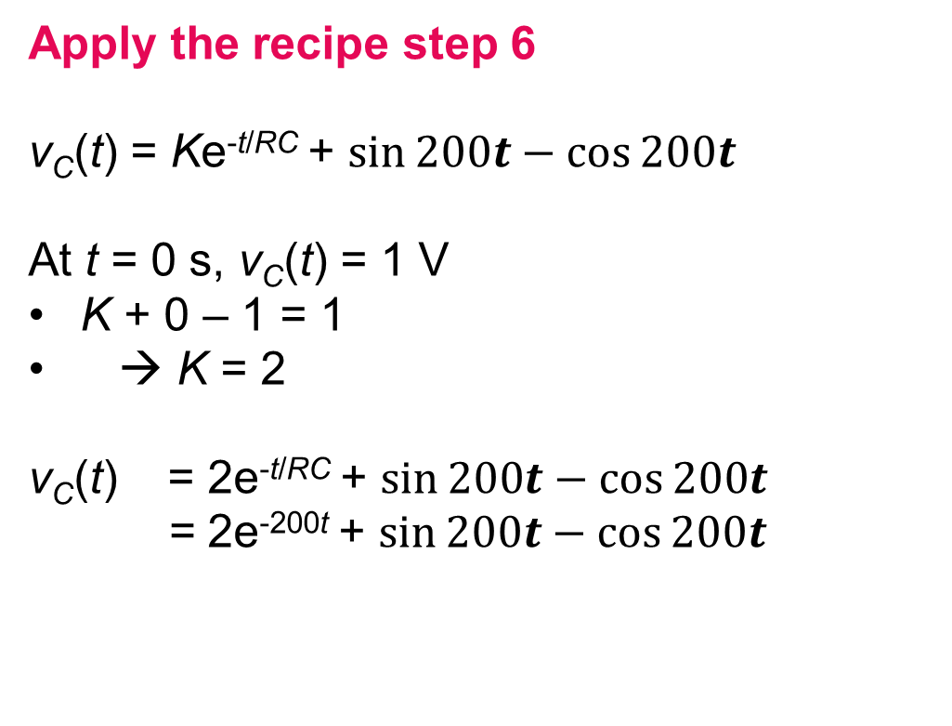
example 4.6
Apply the recipe step 6
v_{C}(t) = Ke^{-t/RC} + $\sin{200t}−\cos{200t}$
At t = 0 s, v_{C}(t) = 1 V
K + 0 – 1 = 1
→ K = 2
v_{C}(t) = 2e^{-t/RC} + $\sin{200t}−\cos{200t}$
= 2e^{-200t} + $\sin{200t}−\cos{200t}$

Slide 19
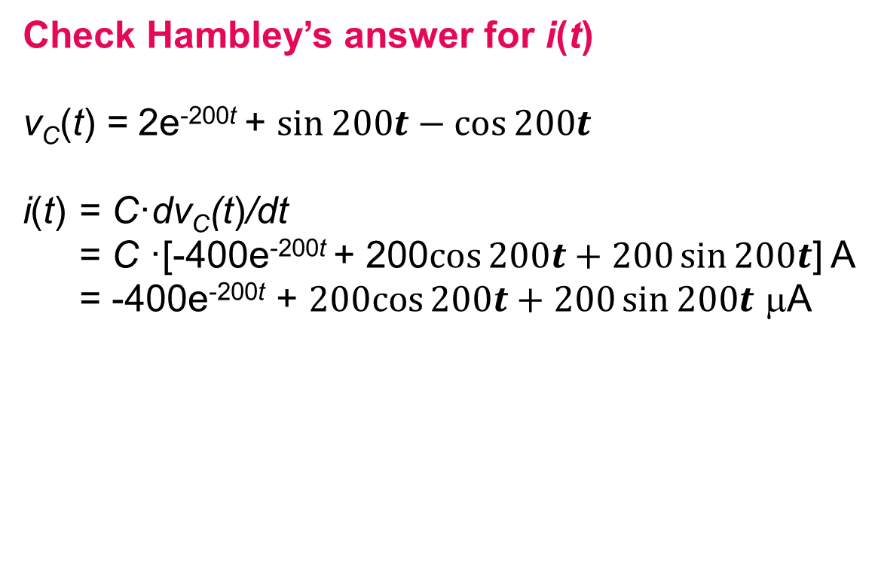
example 4.6
Check Hambley’s answer for i(t)
v_{C}(t) = 2e^{-200t} + $\sin{200t}−\cos{200t}$
i(t) = C·dv_{C}(t)/dt
= C ·[-400e^{-200t} + 200$\cos{200t}+200\sin{200t}$] A
= -400e^{-200t} + $200cos{200t}+200\sin{200t}$ μA

Slide 20
problems for the exercises session
P4.45
P4.47
P4.49
P4.50
P4.51
P4.54

